Slide 1
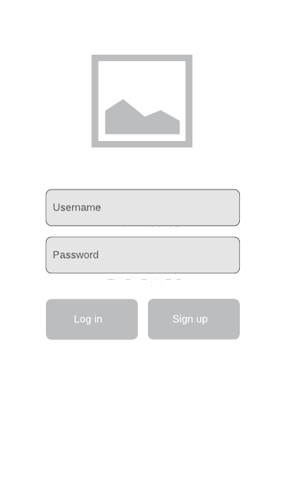
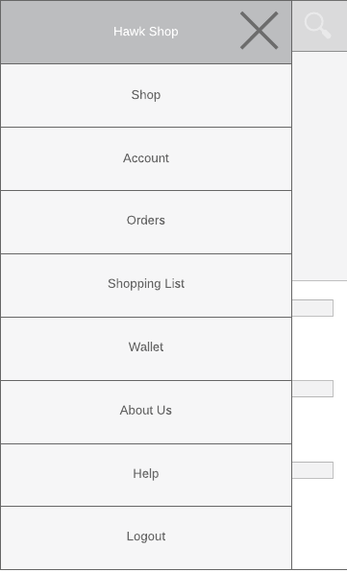
LOGIN SCREEN
Basic Login screen using just a Username Password System
May add remember me checkbox in the future
Need to make signup screen, but will be similar to Login Screen with minor differences
SIDEBAR NAVIGATION
Shows a list of possible places you can navigate to in the app.
Will need to create UI’s for each in the future

Slide 2
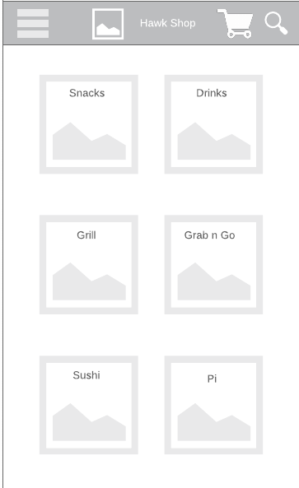
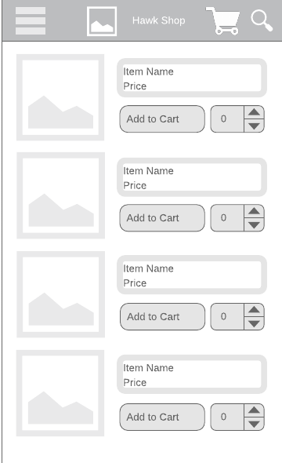
CATEGORY SELECTION
Select Category of food or restaurant that you would like.
Categories from items and shops at lower commons
Categories are dynamic and can be different in other cases
Press image / icon to access items in category
SHOPPING SCREEN
Add quantity of items that you would like to purchase
Number of items added to cart is equal to number in text field
(Default should be 1 - not 0)
Can scroll down to see more items

